Slide 1
About AGB: Vision, Mission, Values, Membership
~DELETE THIS BOX BEFORE USING~
This collection of slides can be used to augment a wide variety of presentations on AGB and governance.
It is not meant to be a single presentation. You can copy/paste any of these slides into your own presentation.

Slide 2
About AGB
The trusted partner for higher education governance.
For more than 100 years, we've helped boards, presidents, and foundation leaders strengthen governance, navigate change, and advance institutional mission.
We equip our members to:
Lead with confidence
Make better decisions
Strengthen leadership
Navigate today's biggest challenges

Slide 3
AGB Members by the Numbers
2,000
Institutions, Systems, and
Foundations
40,000
Individual Board Members
AGB member boards oversee more than
10 million students
(FTE)

Slide 4
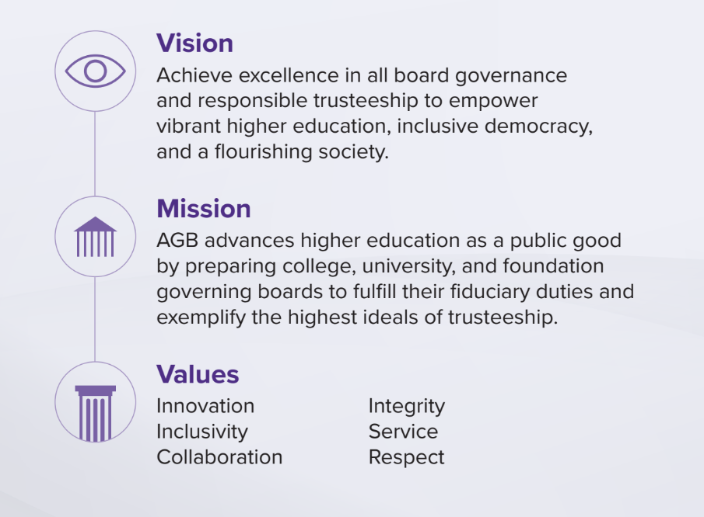
What We Stand For

Slide 5
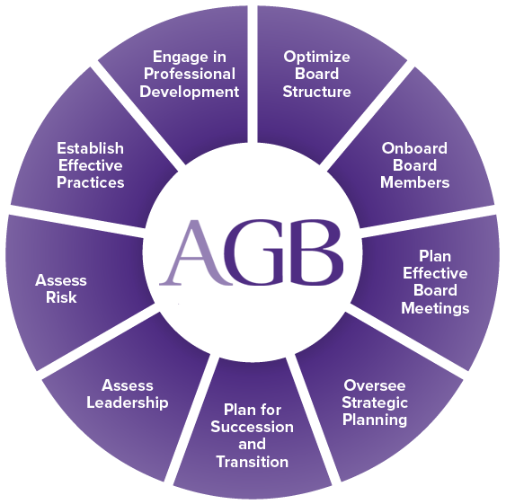
AGB Helps Boards

Slide 6
How AGB Supports Boards
Learn: Build stronger governance through research, education, and practical resources.
Connect: Learn from fellow higher education leaders through conferences, institutes, webinars, peer networks, and more.
Solve: Address complex governance challenges with consulting, board assessments, and expert guidance.
Research | Education | Peer Learning | Consulting | Assessments

Slide 7
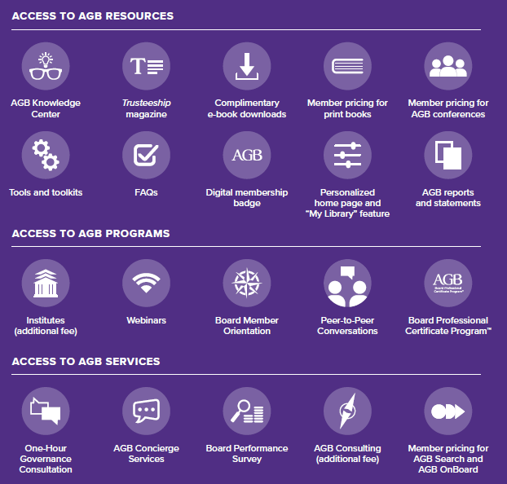
AGB Member Benefits

Slide 8
Top Strategic Issues for Boards
2026–2027

Slide 9
Top Strategic Issues 2026–2027
1. Reaffirming boards’ roles and responsibilities
2. Developing and supporting higher education leaders
3. Improving student access and success
4. Ensuring institutional vitality
5. Renewing higher education’s purpose
KEY QUESTION
What is the role of the board in understanding and addressing these complex challenges and opportunities in ways that make sense for institutions, systems, and foundations?

Slide 10
Strategic Issue #1
Reaffirming boards’ roles and responsibilities
Effective governance depends on boards exercising independent, mission-focused leadership while protecting institutional autonomy.
What This Means for Boards
Focus on long-term strategy and fiduciary oversight.
Safeguard institutional autonomy and academic freedom.
Maintain clear boundaries between governance and management.
Invest in board education, assessment, and continuous improvement.
Questions to Consider
Are we spending enough time on the issues only the board can address?
How do we strengthen board effectiveness in today's environment?
Are we protecting our institution's ability to fulfill its mission?

Slide 11
Strategic Issue #2
Developing and supporting higher education leaders
Strong institutions require strong leadership, and boards play the central role in selecting, supporting, and evaluating presidents and other senior leaders.
What This Means for Boards
Build a strong partnership between the board and president.
Plan proactively for presidential and board leadership transitions.
Support leadership development throughout the institution.
Create conditions that enable leaders to succeed.
Questions to Consider
How prepared are we for our next leadership transition?
Are we providing our president with the support needed to succeed?
Does our institution have a strong pipeline of future leaders?

Slide 12
Strategic Issue #3
Improving student access and success
Student success should remain at the center of every board's strategic oversight and decision-making.
What This Means for Boards
Monitor enrollment, retention, completion, and student outcomes.
Promote affordability and broaden educational access.
Ensure academic offerings meet evolving learner and workforce needs.
Use data to evaluate institutional performance and impact.
Questions to Consider
How are we measuring student success?
Are our strategic decisions improving outcomes for current and future students?
How are we demonstrating the value of a college education?

Slide 13
Strategic Issue #4
Ensuring institutional vitality
Boards must help their institutions adapt to changing demographics, financial pressures, technology, and an evolving higher education landscape.
What This Means for Boards
Strengthen long-term financial sustainability.
Encourage innovation while remaining grounded in mission.
Evaluate strategic partnerships and new opportunities.
Understand the opportunities and risks of emerging technologies, including AI.
Questions to Consider
Is our institution positioned to thrive over the next decade?
Where should we innovate—and where should we remain disciplined?
Are we making decisions that strengthen long-term resilience?

Slide 14
Strategic Issue #5
Renewing higher education’s purpose
Governing boards have an important role in strengthening public confidence and reaffirming higher education's value to society.
What This Means for Boards
Champion the institution's mission and public purpose.
Communicate the value and impact of higher education.
Foster transparency, accountability, and ethical leadership.
Help build public trust through effective governance.
Questions to Consider
How are we demonstrating our institution's value to our communities?
Are we reinforcing trust through our actions and decisions?
How does our governance reflect our mission and values?

Slide 15
Board Structure, Culture, and Related Topics

Slide 16
Distinctions between corporate and higher education boards
Public Corporations
Maximize shareholder value
Stakeholders: mostly shareholders
Public Colleges and Universities
Serve educational and public service mission
Stakeholders: students, faculty, staff, alumni, lawmakers, public
Performance metrics: broad
Performance metrics: mostly financial

Slide 17
What Good Governance Requires
Good governance depends on four elements:
Right Composition
Right Focus
Right Relationships
Discernment
Boards must continually determine what is right for their institutions in light of changing circumstances.
Notes:
Strong governance depends not only on structure, but on judgment. Effective boards align who serves, what they focus on, and how they work together.

Slide 18
The Board’s Core Governance Role
The governing board holds ultimate responsibility for governance.
The board is accountable for the institution’s:
Mission and heritage
Strategic direction
Responsibility to the public and legitimate constituents
The board should retain ultimate authority to determine the mission, in consultation with the president.
Notes:
The board governs at the institutional level and is responsible for ensuring the institution remains mission-centered and strategically directed.

Slide 19
Core Responsibilities of the Board
Defining and stewarding the mission
Selecting, supporting, and assessing the president
Reviewing presidential compensation
Participating in and approving strategic planning
Monitoring strategic performance
Ensuring financial sustainability and protecting institutional assets
Engaging directly in fundraising and philanthropy
Ensuring educational quality
Safeguarding autonomy and academic freedom
Maintaining effective governance policies
Notes:
These core responsibilities reflect the board’s institutionwide fiduciary and strategic role. They span mission, leadership, finance, educational quality, and institutional values.

Slide 20
Board Culture and Board Conduct
Effective boards:
Focus on the big picture and long-term sustainability
Work as a collective body
Strengthen shared governance
Engage regularly with major constituencies
Ensure board business is conducted in an exemplary fashion
Periodically assess the performance of the board, committees, and members
Notes:
Boards should be intentional about how they govern, not just what they govern. Governance quality depends on both focus and process.

Slide 21
What Boards Should Not Do
Effective boards should not:
Micromanage the administration
Focus excessively on routine operations
Allow meetings to be dominated by passive reports
Permit factions or independent action by individual trustees
Undermine the president publicly
Notes:
The board’s role is oversight, judgment, and stewardship—not operational management.

Slide 22
Responsibilities of Individual Trustees
Individual board members should:
Put the institution’s interests first
Serve as independent fiduciary agents
Think independently but act collectively
Be open-minded and amenable to persuasion
Respect dissent, confidentiality, and board processes
Serve as ambassadors for the institution and for higher education
Notes:
Trustees should not act as delegates for outside groups or interests. Their loyalty belongs to the institution.
Trustees should not act as delegates for outside groups or interests. Their loyalty belongs to the institution.

Slide 23
Standards for Individual Conduct
Trustees are expected to:
Conduct themselves with high integrity
Honor the duties of integrity, care, loyalty, and obedience
Respect academic culture and governance norms
Support ethical decision-making and conflict-of-interest standards
Contribute to a culture of reflection, accountability, and inclusion
Notes:
Because trustees sit at the top of the governance structure, they must model the ethical standards they expect throughout the institution.

Slide 24
Key Takeaways
Boards are responsible for governing the institution by:
Defining mission and direction
Selecting and supporting leadership
Overseeing strategy, finances, educational quality, and policy
Protecting autonomy and academic freedom
Governing with integrity and accountability
Individual trustees are responsible for:
Serving loyally and ethically
Exercising sound judgment
Strengthening the board’s collective effectiveness
Notes:
Good governance depends on both a strong board and effective trustees. The institution benefits when responsibilities are clear and exercised well.

Slide 25
Board Structure
Board Composition
Priorities
What are our priorities?
Committee Structure
What committees do we need?
Board size
Skill sets, experiences, backgrounds
What do we discuss in executive session?
What staff should support?
When do we need information from management?

Slide 26
Healthy vs. Unhealthy Boards
Healthy
Unhealthy
Distributed Influence
Open-Minded Listeners
Constructive Dissent
Collective Wisdom
Transparency
Dominant Inner Circle
Closed-Minded Speakers
Back-Channel Agitation
Individual Convictions
Opacity
Adapted from “The Bedrock of Board Culture,” by Richard Chait. Trusteeship magazine, May/June 2016.

Slide 27
Healthy vs. Unhealthy Boards
Healthy
Unhealthy
Confidentiality
Respect and Trust
Clear Expectations
Diligence
Mutual Accountability
Seepage
Disregard and Distrust
Ambiguous Expectations
Disengagement
Collective Immunity
Adapted from “The Bedrock of Board Culture,” by Richard Chait. Trusteeship magazine, May/June 2016.

Slide 28
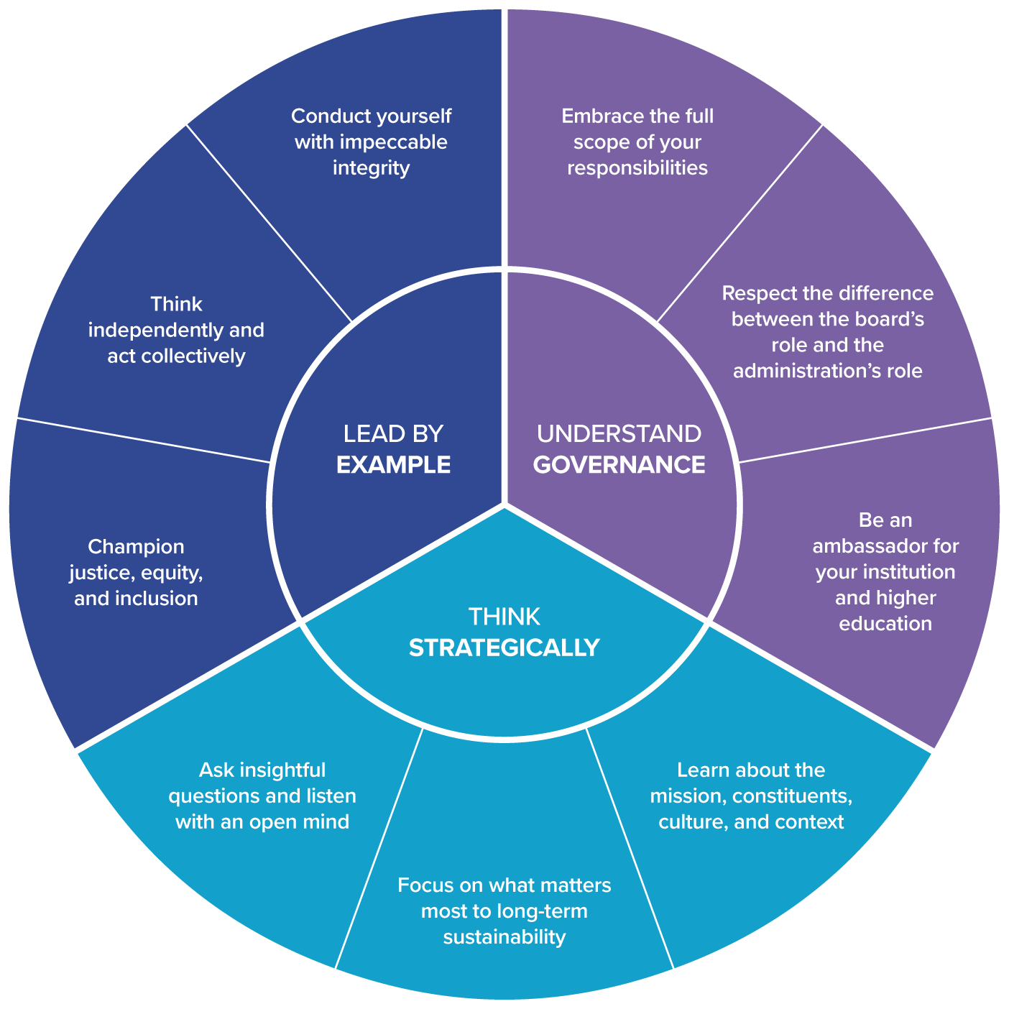
Principles of Trusteeship for Individuals

Slide 29
Ten Habits of a Highly Effective Board
5. Establish a strong governance committee.
4. Select an effective board chair.
3. Cultivate a healthy relationship with the president.
2. Uphold basic fiduciary duties.
1. Create a culture of inclusion.

Slide 30
Ten Habits of a Highly Effective Board
10. Focus on accountability.
9. Develop a renewed commitment to shared governance.
8. Provide appropriate oversight of academic quality.
7. Consider strategic risk factors.
6. Delegate appropriate decision-making authority to committees.

Slide 31
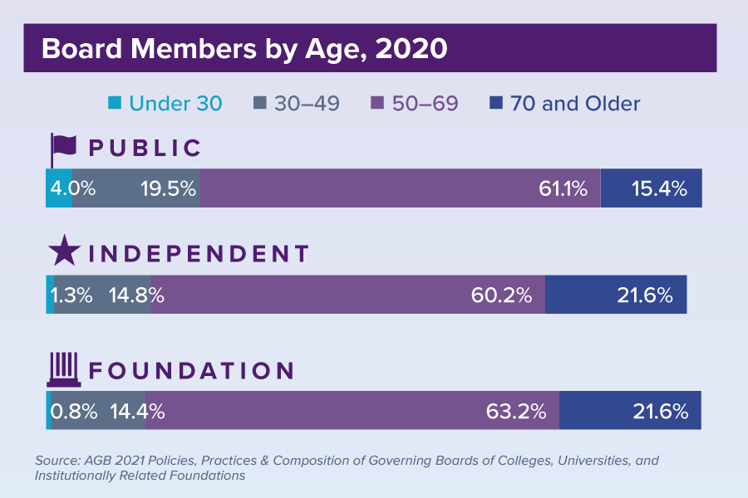
Governing Board Stats

Slide 32
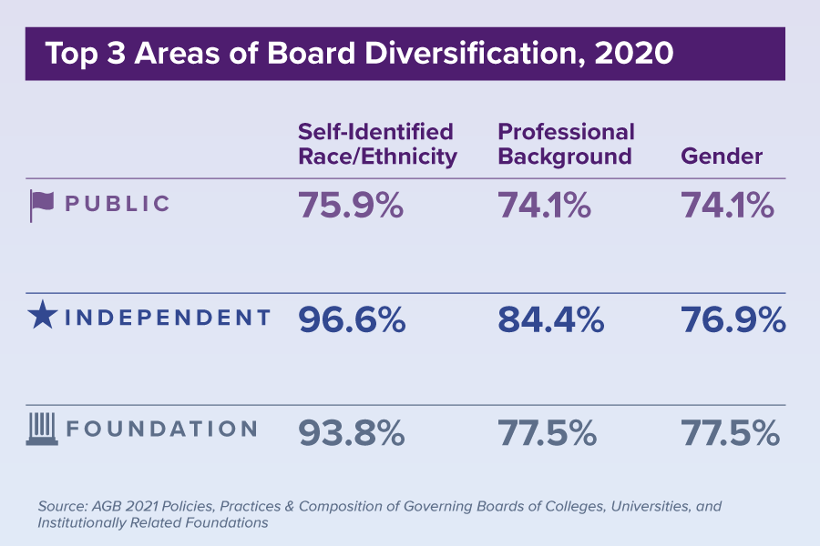
Governing Board Stats

Slide 33
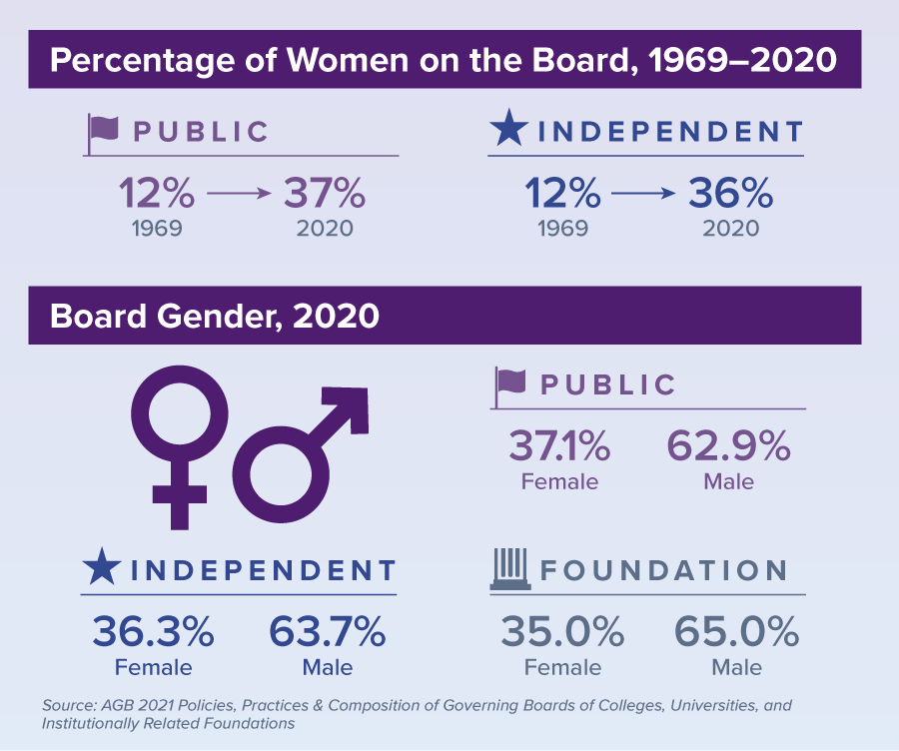
Governing Board Stats

Slide 34
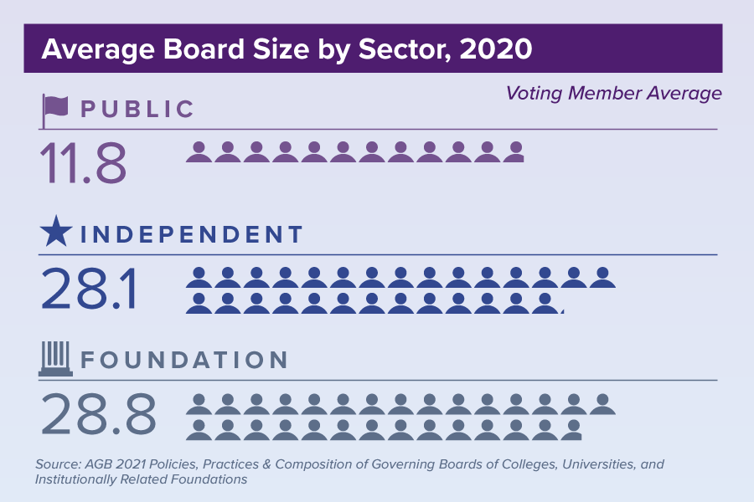
Governing Board Stats

Slide 35
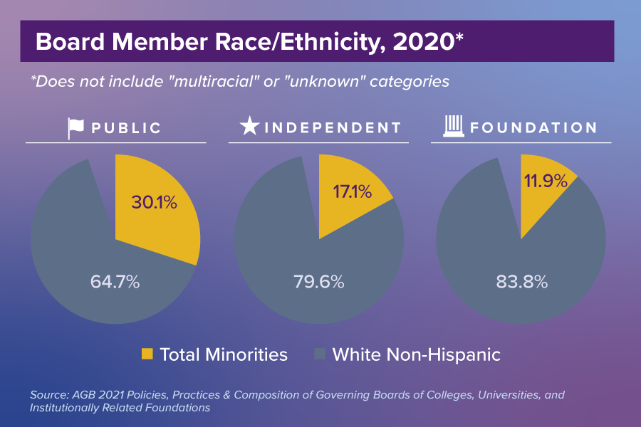
Governing Board Stats

Slide 36

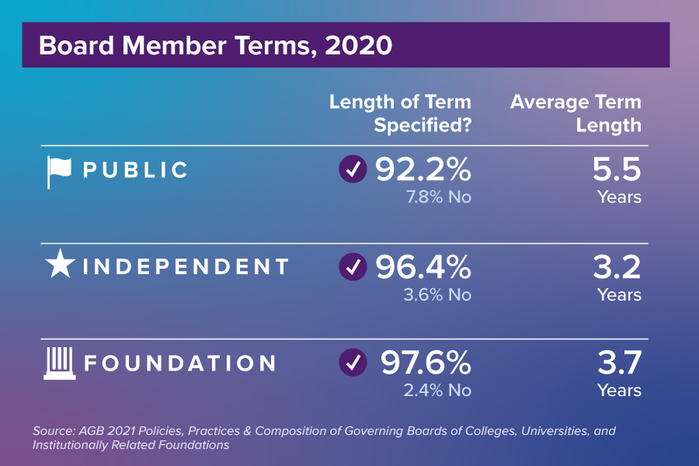
Governing Board Stats

Slide 37
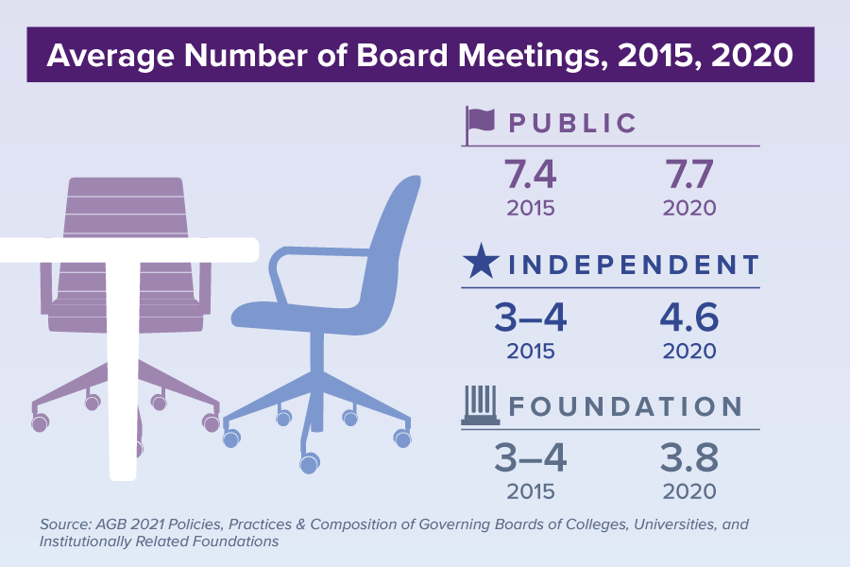
Governing Board Stats

Slide 38
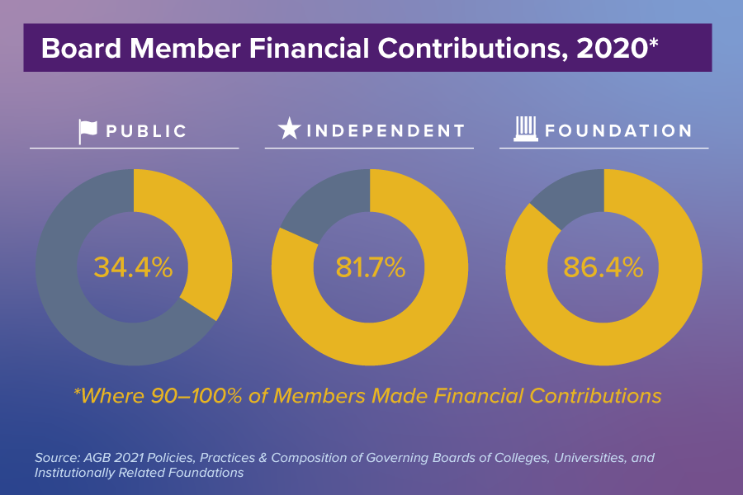
Governing Board Stats

Slide 39


Slide 40
An AGB Quick Take

